Slide 1
UI Design and Development
+Roman Nurik +Nick Butcher

Slide 2
Agenda
Designing for Android
Layouts and resources
Tablet considerations
System UI integration
Wireframing

Slide 3
Designing for Android

Slide 4
d.android.com/design

Slide 5
Design for…
Touch
Interact primarily with your fingers
Expect direct manipulation
Mobile
Often on the go
Often without network connectivity
Heterogeneity
Different screen sizes and densities
Different hardware features
Different OS versions

Slide 6
Key principles
“Pictures are faster than words.”
“Only show what I need when I need it.”
“Make the important things fast.”
“Do the heavy lifting for me.”

Slide 7
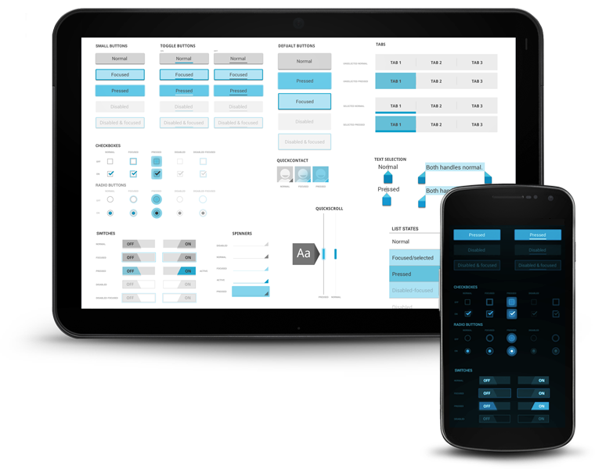
“Holo” visual language
Notes:
Futuristic but approachable
Blue accents throughout
Focus on typography and spacing
Minimize use of lines, boxes, borders

Slide 8
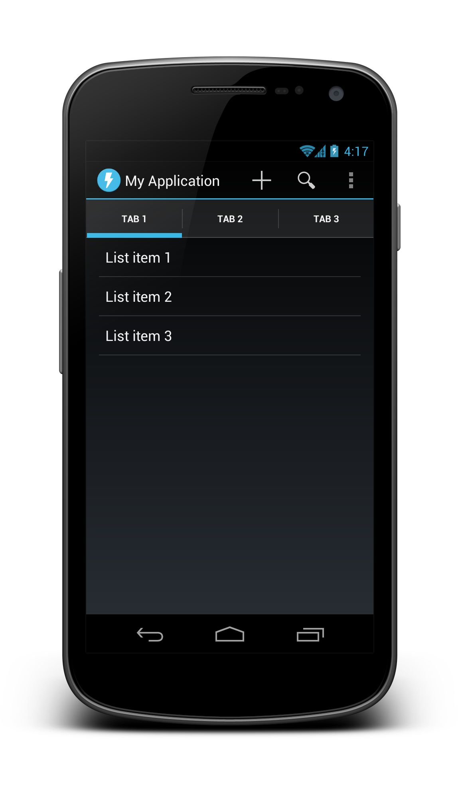
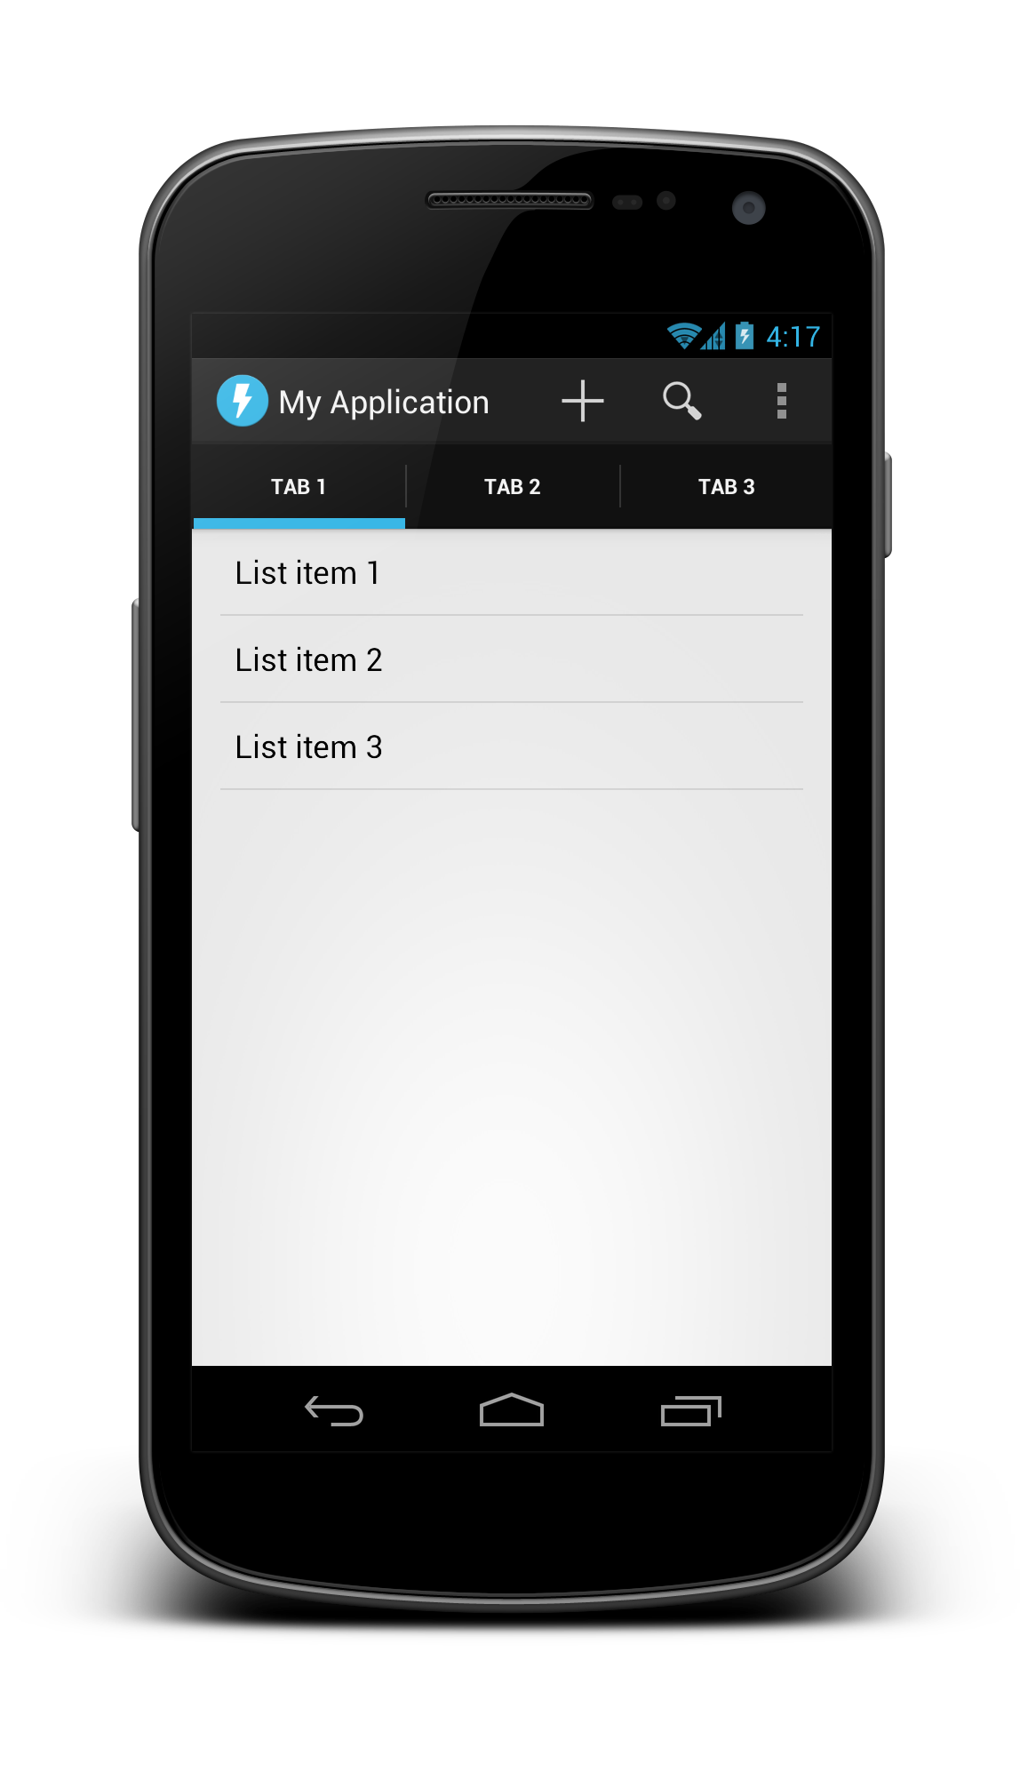
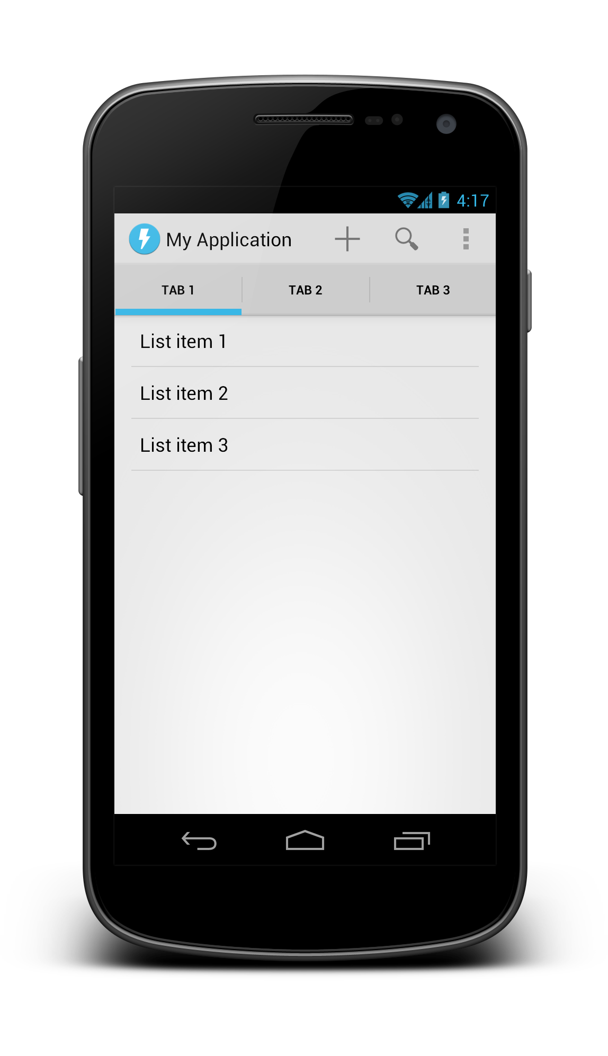
Holo variations
Dark
Dark Action Bar
Light

Slide 9
Activity UI structure
Action bar
Tabs
Content (activity layout)

Slide 10
Activity UI structure
Action bar

Slide 11
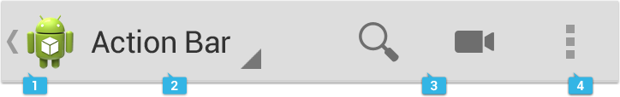
Action bar
App icon and optional Up caret
View control (Title/tabs/dropdown)
Action buttons
Action overflow

Slide 12
Action bar
Automatically added to modern apps
Customizable
getActionBar().setDisplayOptions()
getActionBar().setNavigationMode()
Themeable

Slide 13
Activity UI structure
Action bar

Slide 14
Activity UI structure
Tabs

Slide 15
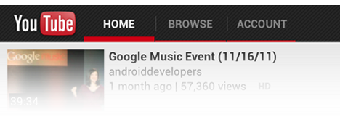
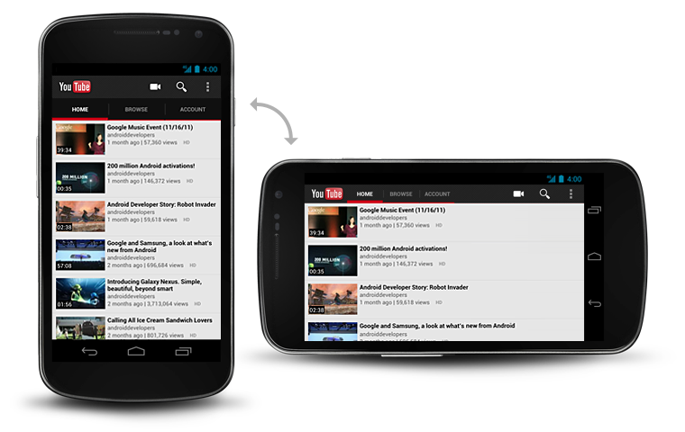
Tabs
Notes:
In landscape, and on tablets, tabs are collapsed into the main action bar row. Otherwise they are in a separate row

Slide 16
Tabs
Part of the ActionBar APIs
Usually gesture-enabled using ViewPager
getActionBar().setNavigationMode(NAVIGATION_MODE_TABS);
ActionBar.Tab tab = actionBar.newTab();
tab.setText(“Tab 1”);
tab.setTabListener(this);
getActionBar().addTab(tab);

Slide 17
EXERCISE Create an app with an action bar + tabs

Slide 18
Activity UI structure
Tabs

Slide 19
Activity UI structure
Content (activity layout)

Slide 20
Layouts and resources

Slide 21
Layout system
The UI for an activity is a tree consisting of view groups and views (leaf nodes), like HTML.
Most commonly defined in XML under res/layout/.
<view group>
<view group>
<view>
<view group>
<view>
<view>

Slide 22
Views and View Groups
Views
View Groups
Reusable individual UI components
Optionally interactive (clickable/focusable/etc.)
Bare minimum functionality is to draw themselves
Ordered list of Views and View Groups
In charge of positioning and sizing their child views and layouts
Simple layouts and more complex groups (e.g. ListView)

Slide 23
Views and View Groups
Views
Layouts (simple View Groups)
TextView
EditText
Spinner
Button
ImageView
ImageButton
WebView
SurfaceView
Your own custom views
FrameLayout
LinearLayout
RelativeLayout
GridLayout
Your own custom layouts
Complex View Groups
ScrollView
ListView

Slide 24
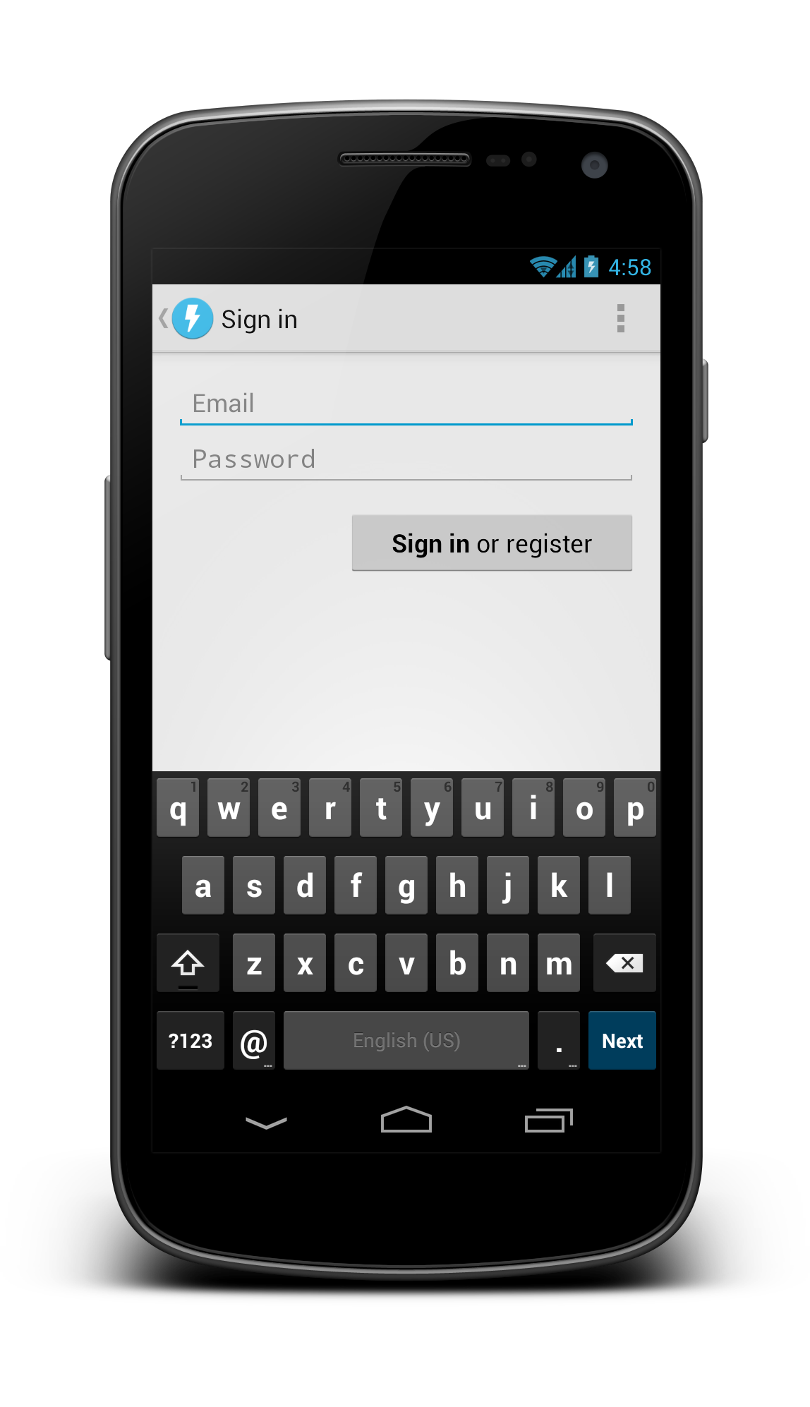
Anatomy of a simple layout

Slide 25
<LinearLayout orientation=“vertical”>
<EditText>
<Button>
<ScrollView>

Slide 26
<ScrollView
android:layout_width="match_parent"
android:layout_height="match_parent">
<LinearLayout
android:layout_width="match_parent"
android:layout_height="wrap_content"
android:orientation="vertical"
android:padding="16dp">
<EditText
android:id="@+id/email"
android:layout_width="match_parent"
android:layout_height="wrap_content"
android:hint="@string/prompt_email"
android:inputType="textEmailAddress"
android:singleLine="true" />
<EditText
android:id="@+id/password"
android:layout_width="match_parent"
android:layout_height="wrap_content"
android:hint="@string/prompt_password"
android:inputType="textPassword” android:singleLine="true" />
<Button
android:id="@+id/sign_in_button"
android:layout_width="wrap_content"
android:layout_height="wrap_content"
android:layout_gravity="right"
android:layout_marginTop="16dp"
android:paddingLeft="32dp"
android:paddingRight="32dp"
android:text="@string/action_sign_in_register" />
</LinearLayout>
</ScrollView>

Slide 27
Important layout attributes
android:layout_weight
Children of LinearLayout
android:layout_gravity
Children of FrameLayout, LinearLayout
android:gravity
TextView, LinearLayout

Slide 28
Margins and padding
android:layout_margin
Sign in or register
android:padding

Slide 29
EXERCISE Code this layout

Slide 30
Button
Button
Button
Button

Slide 31
<FrameLayout>
<LinearLayout orientation=“vertical”>
Button
Button
Button
Button
<LinearLayout orientation=“horizontal”
layout_weight=“1”>

Slide 32
Fixed header
List view
Fixed footer

Slide 33
<LinearLayout>
Fixed header
List view
<ListView layout_weight=“1”>
Fixed footer
layout_height=“wrap_content”

Slide 34
App resources
res/
drawable
drawable-xhdpi
drawable-hdpi
drawable-mdpi
layout
layout-land
layout-large
layout-large-land
One universal app binary contains all resources
System chooses at runtime which resources to use

Slide 35
res/
drawable
drawable-xhdpi
drawable-hdpi
drawable-mdpi
layout
layout-land
layout-large
layout-large-land
values
values-v11
values-v14
values-en
values-fr
values-ja
Drawable XML
PNGs, 9-patch PNGs, optimized for multiple densities
Layout XML optimized for physical screen size and orientation
Strings, styles, themes, etc.
Styles, themes varying by API level
Strings XML localized for your target regions

Slide 36
Referencing resources
A string in res/values/strings.xml
In Java: R.string.hello
In XML: @string/hello
The system “edit” icon:
In Java: android.R.drawable.ic_menu_edit
In XML: @android:drawable/ic_menu_edit

Slide 37
Referencing resources
android.R.drawable.ic_menu_edit
@android:drawable/ic_menu_edit
Namespace (either android or blank)
Resource type
Resource name

Slide 38
Screen density and DIP units
DIP units keep things the same physical size across any screen.
1 dip = 1 pixel @ MDPI (160 dpi)
1 dip = 2 pixels @ XHDPI (320 dpi)

Slide 39
Q: What is the Nexus 7’s screen resolution in DIPs if it’s 1280x800 px and 213dpi?
A: ~960x600 dip

Slide 40
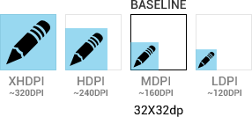
Screen density and DIP units
Icons and other PNG files should generally be provided for multiple densities

Slide 41
Key drawable types
Bitmaps (.png)
9-patches (.9.png)
State Lists (.xml)

Slide 42
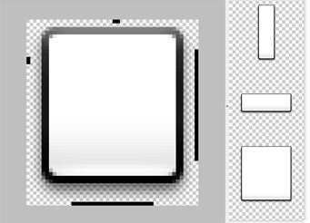
9-patches – foo.9.png
Border pixels indicate stretchable regions
Make density-specific versions (-xhdpi)

Slide 43
State list drawables
drawable/
foo.xml
<selector>
<item android:drawable="@drawable/foo_disabled"
android:state_enabled="false" ... />
<item android:drawable="@drawable/foo_pressed"
android:state_pressed="true" ... />
<item android:drawable="@drawable/foo_focused"
android:state_focused="true" ... />
<item android:drawable="@drawable/foo_default" />
</selector>

Slide 44








State list drawables
drawable-mdpi/
foo_default.png
foo_disabled.png
foo_focused.png
foo_pressed.png
drawable-hdpi/
foo_default.png
foo_disabled.png
foo_focused.png
foo_pressed.png

Slide 45
Styles
Collections of layout XML attribute values, kind of like CSS
Instead of this…
<TextView
android:layout_width="match_parent"
android:layout_height="wrap_content"
android:padding="4dp"
android:text="1" />
<TextView
android:layout_width="match_parent"
android:layout_height="wrap_content"
android:padding="4dp"
android:text="2" />

Slide 46
Styles
<TextView style="@style/MyText"
android:text="1" />
<TextView style="@style/MyText"
android:text="2" />
…use this!
res/values/
styles.xml
<style name="MyText">
<item name="android:padding">4dp</item>
<item name="android:layout_width">match_parent</item>
<item name="android:layout_height">wrap_content</item>
</style>

Slide 47
Themes
Are styles that apply to whole activities (or the entire app)
AndroidManifest.xml
<application android:theme="@android:style/Theme.Holo">
...
</application>

Slide 48
Themes
@android:style/Theme.Holo
@android:style/Theme.Holo.Light.DarkActionBar
@android:style/Theme.Holo.Light

Slide 49
Themes
Like styles, themes are extensible
<style name="MyTheme" parent="@android:style/Theme.Holo">
...
</style>

Slide 50
EXERCISE Change your app’s theme to Holo Light

Slide 51
Tablet considerations

Slide 52
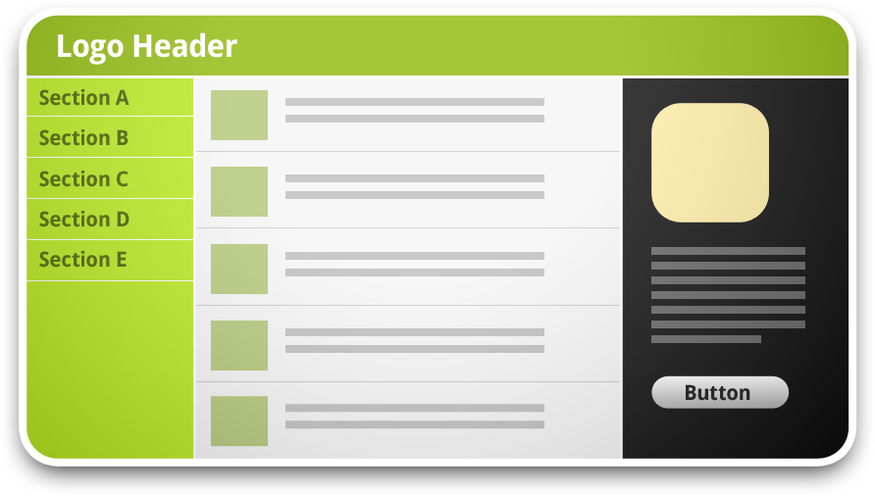
Information hierarchy and flow
Traditional desktop app or website

Slide 53
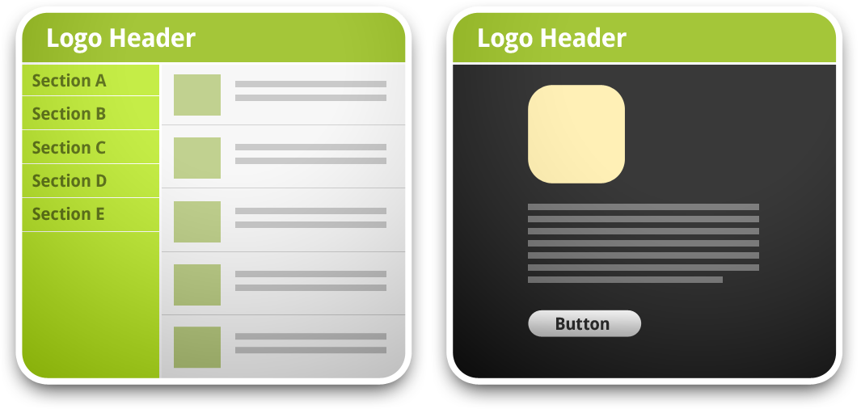
Information hierarchy and flow
Tablet or mini desktop app

Slide 54
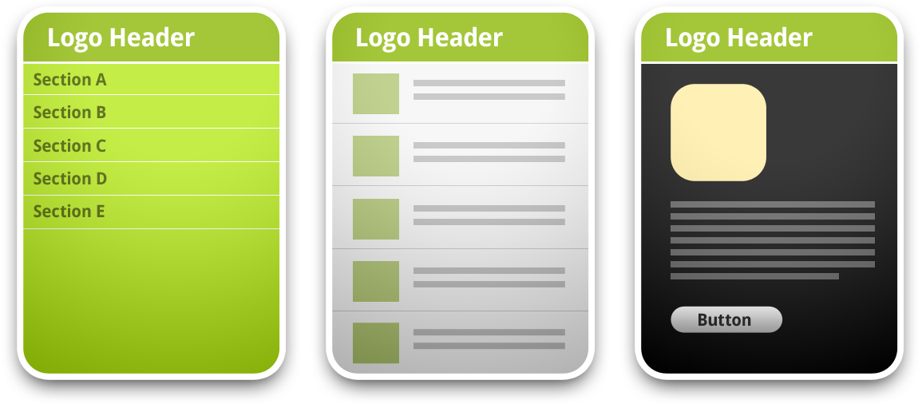
Information hierarchy and flow
Mobile phone app

Slide 55
Fragments
Separate activities into UI or code modules, each have their own class
Help with supporting phones + tablets
Each content pane is a fragment
Fragments split across activities
<fragment> in layout XML
Automatically instantiates the given fragment
Acts as a placeholder for the fragment’s view to be inserted in that part of the layout tree

Slide 56
Tablet resources
Customize layouts for large screens
Includes <fragment> tags
Incrementally increase font sizes, spacing, tweak styles
res/
layout-large/
values-large/
dimens.xml
styles.xml

Slide 57
System UI integration

Slide 58
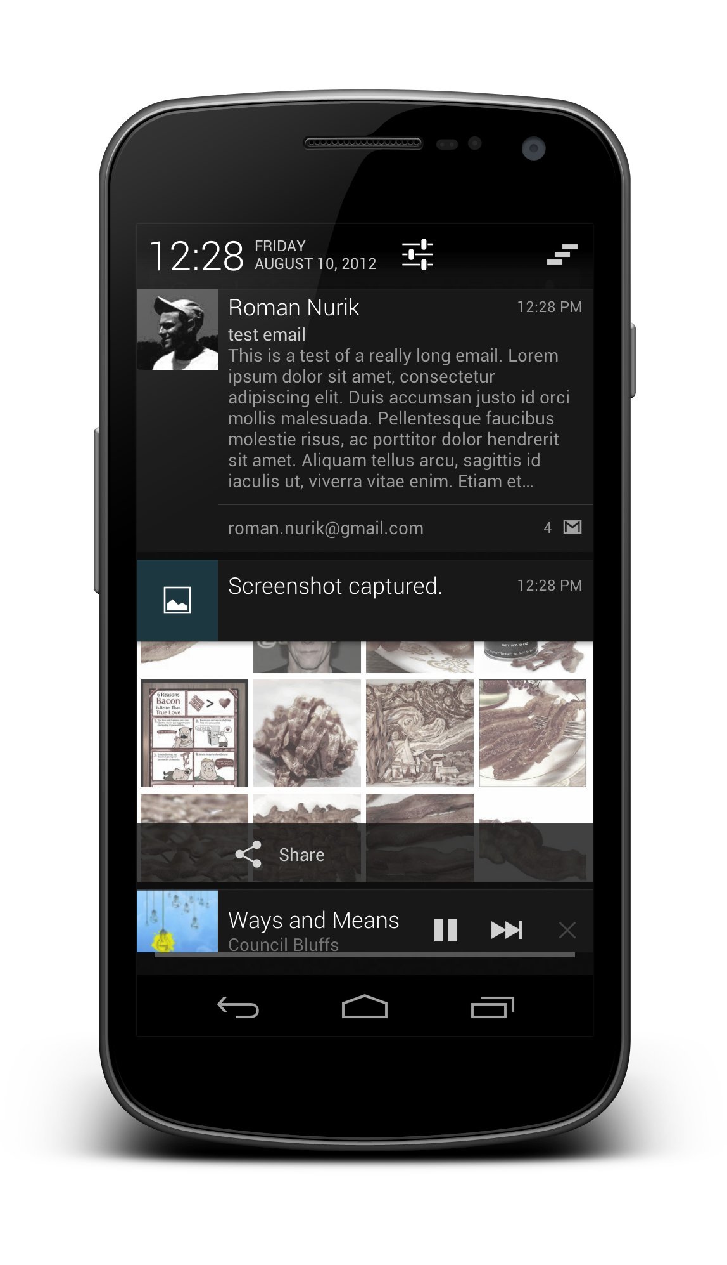
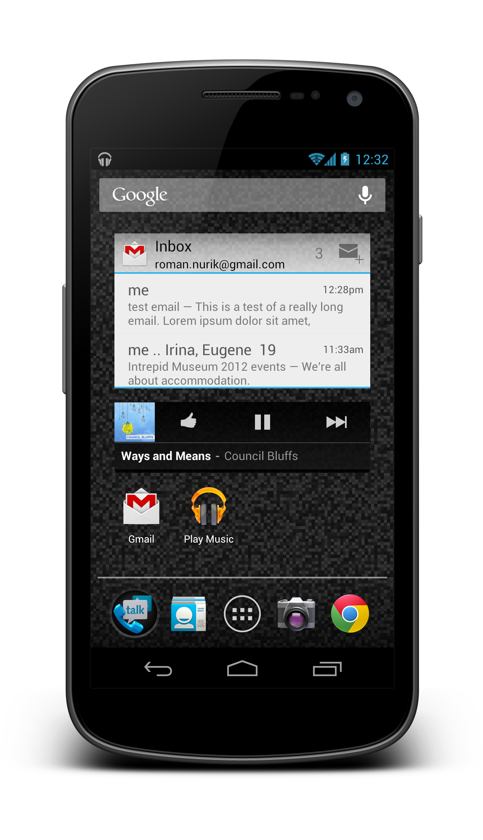
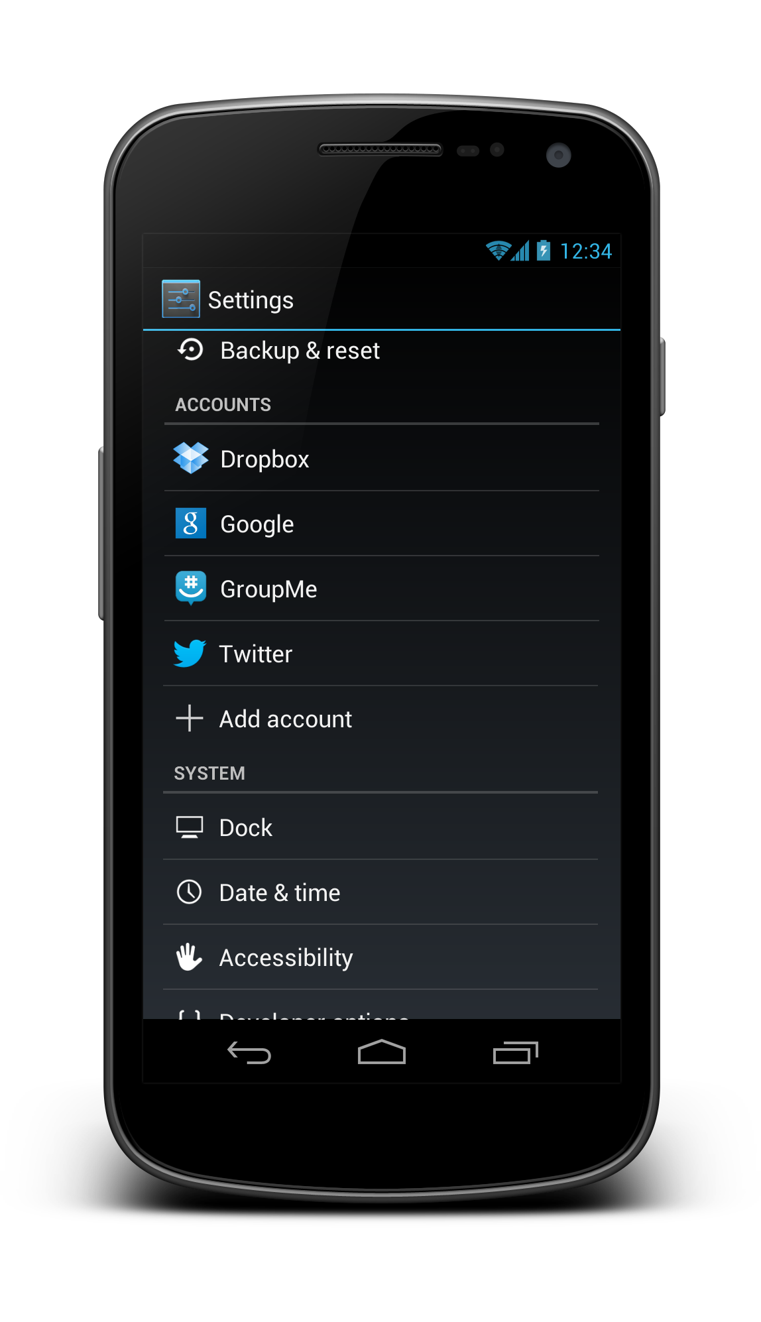
System UI integration
Notifications
App Widgets
Accounts + Sync

Slide 59

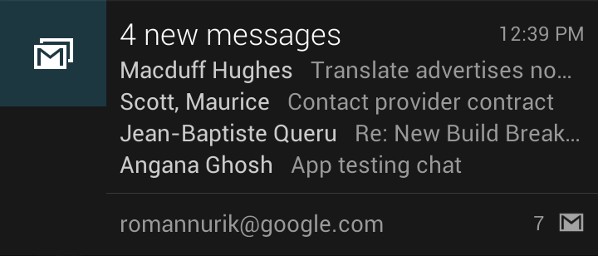
Notifications
Iconified
Collapsed
Expanded Android 4.1+

Slide 60
Notifications
Interactive

Slide 61
Notifications
Created with NotificationManager and Notification.Builder()
Custom layouts with RemoteViews
Your layouts, used in a different process
Interaction is handled entirely using intents

Slide 62
App widgets
Scrollable
Resizable
Interactive

Slide 63
App widgets
Defined in your manifest as a receiver
Handles the APPWIDGET_UPDATE intent action
Metadata provided in res/xml/widgetinfo.xml and referenced in manifest
Layout using RemoteViews
Your layouts, used in a different process
Interaction is handled entirely using intents

Slide 64
EXERCISE Show a notification in your project
Hint: use NotificationManager

Slide 65
Wireframing

Slide 66
Why create wireframes?
Record your ideas and asses their real-world feasibility
Test your your ideas and rapidly iterate
See which work and which don’t, evolve them
Map out user flow and activity diagrams
Re-arrange/add/remove interactions quickly
Scope UI complexity
Plan out intra-app “Intent-based API”

Slide 67
Wireframing before coding saves you time.

Slide 68
Wireframing tools
Time/Effort
Photoshop
OmniGraffle (Mac)
Fireworks
Keynote/Powerpoint
Fluid UI
Balsamiq
Pencil (Firefox addon)
Eclipse Layout Editor
Wireframe Sketcher
Pen + Paper
Fidelity

Slide 69
Wireframing tools
Time/Effort
Interactive
wireframes
Photoshop
OmniGraffle (Mac)
Fireworks
Keynote/Powerpoint
Fluid UI
Balsamiq
Pencil (Firefox addon)
Eclipse Layout Editor
Wireframe Sketcher
Pen + Paper
Fidelity

Slide 70
Wireframing tools
Time/Effort
Photoshop
OmniGraffle (Mac)
Fireworks
Recommended
tools
Keynote/Powerpoint
Fluid UI
Balsamiq
Pencil (Firefox addon)
Eclipse Layout Editor
Wireframe Sketcher
Pen + Paper
Fidelity

Slide 71
Always start with pencil and paper. (or a whiteboard)

Slide 72
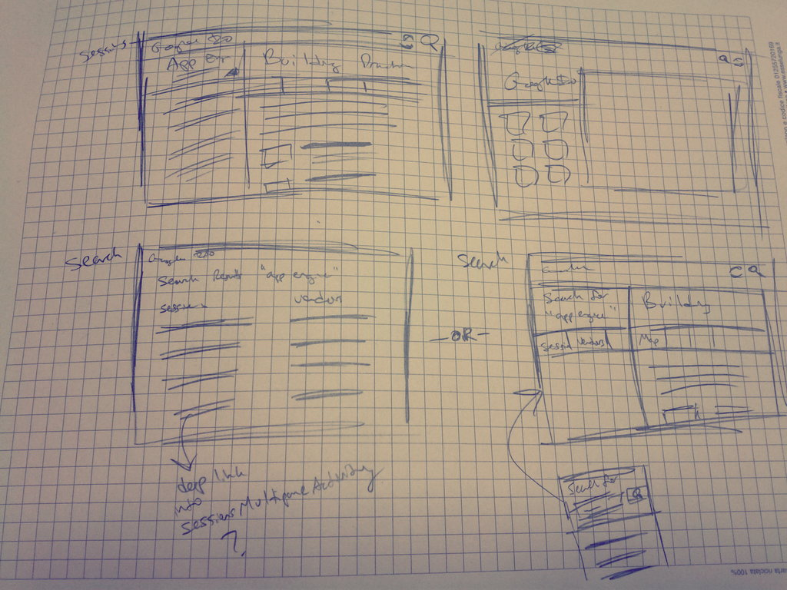
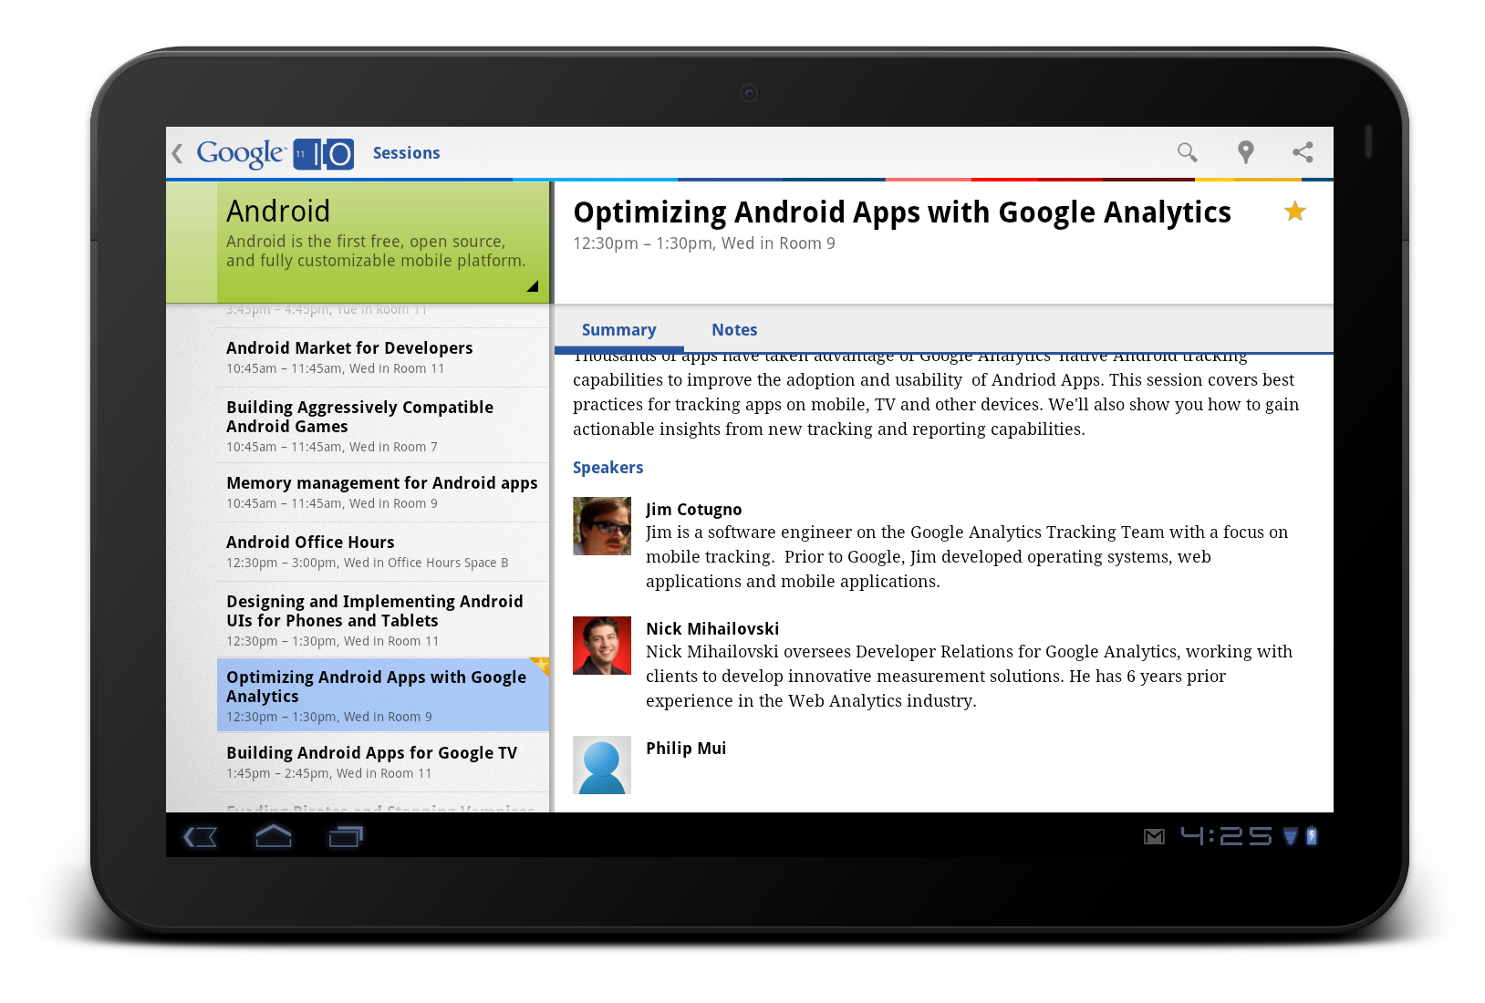
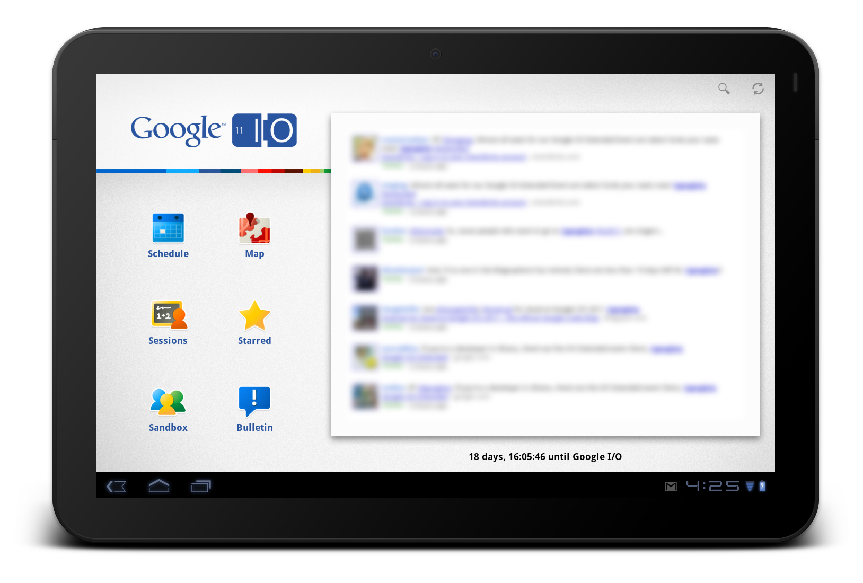

Slide 73
EXERCISE Sketch a todo list app

